Slide 1

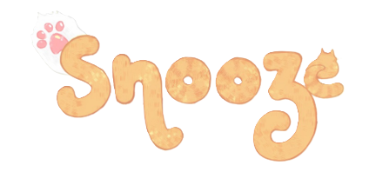

An AI Powered Fashion Discovery Platform
TEAM- 4

Slide 2
OVERVIEW
Introduction
The Problem
Our Solution
Key Features- Image Bsed Search
Technology Stack- Image Based Search
Key Features- Text based search
Technology Stack- Text Based Search
Design and User Experience
Stakeholders
Future Potential
Thank You
1

Slide 3
INTRODUCTION- THE WORLD OF FASHION
Fashion is constantly evolving.
Users want to discover timely, on-trend items without manually filtering through outdated results.
They jump between platforms just to find or track down one style or product.
Most sites rely on keyword-based search.
By combining image-based and natural language search, Snooze provides a smart, unified discovery tool for fashion
2

Slide 4
THE PROBLEM- FASHION DISCOVERY CHALLANGES
Missed Opportunities for Brands
Fragmented Shopping Experience
Brands miss sales as products stay hidden without smart, AI drvien search
Shoppers jump between multiple platforms to find one product
Shoppers Settle or Abandon Search
Style Overload Without Personalization
When results aren’t relevant or fast, users either abandon the search or settle for less preferred options.
Users are overwhelmed by irrelevant results
3

Slide 5
OUR SOLUTION- SNOOZE
Snooze is an AI-powered fashion discovery platform designed to make shopping easier and more personalized. Our platform helps users find exactly what they’re looking for, whether through image-based or text-based search. With Snooze, discover fashion in a whole new way.
1.
2.
3.
Get personalized, accurate recommendations
Search using images or text
Find products that match your preferences
4.
5.
Discover new styles and trends
Powered by AI for smarter results
4

Slide 6
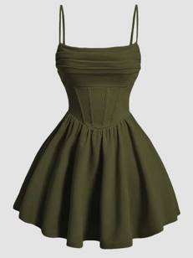

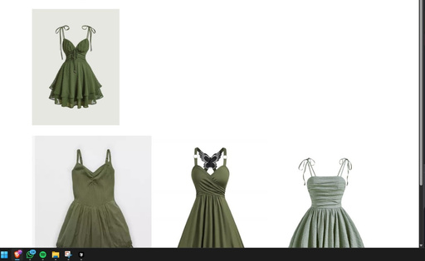
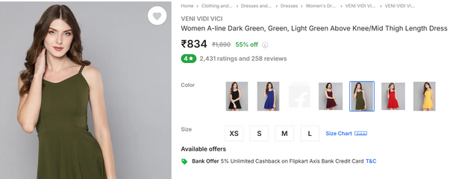
Upload a Clothing photo
Snap or select any outfit image
KEY FEATURES- IMAGE BASED SEARCH
AI Analyzes the Image
Detects color, type, and style
Finds Similar Styles Fast
Matches with visually alike items
Browse Multiple Retailers
5
Explore product links instantly

Slide 7

TECHNOLOGY STACK- IMAGE BASED SEARCH
IMAGE PROCESSING
Programming Language
sharp for image manipulation (resizing, etc.)
Python
Libraries
Deep Learning Model
pandas (for data handling)
numpy (for numerical operations)
requests (for fetching images from URLs)
PIL (Python Imaging Library) (for image processing)
TensorFlow, Keras (for deep learning)
scikit-learn (cosine similarity)
ResNet50 (for feature Extraction)
3
6

Slide 8

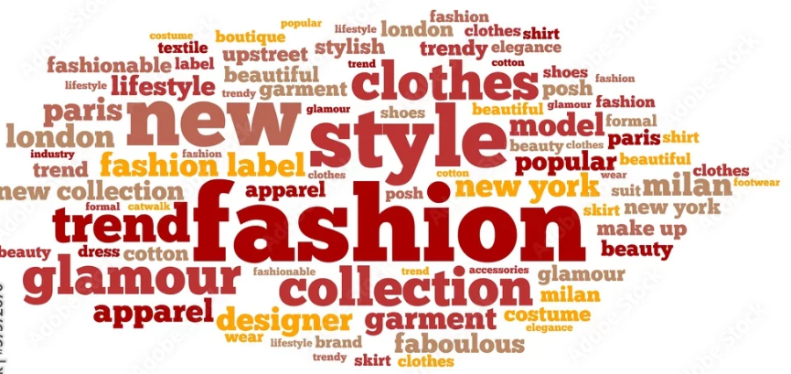
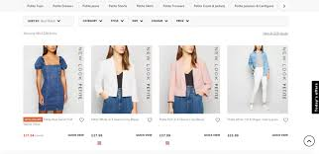
KEY FEATURES- TEXT BASED SEARCH
Describe what you want
AI understands your terms
Smart Filter Refines results
Get Fast, Accurate Matches
Type in fashion-related keywords
Interprets style and colour
Narrow by occasion and gender
See items that fit your vision
7

Slide 9
TECHNOLOGY STACK- TEXT BASED SEARCH
Programming Language
NLP Library
Python
Sentence Transformers ('all-MiniLM-L6-v2' model)
Data Handling
Similarity Measurement
pandas (for data manipulation)
scikit-learn (cosine similarity)
3
8

Slide 10
DESIGN AND USER EXPERIENCE
Goal
Backend
Frontend
Intuitive and easy-to-navigate interface
Clean and visually appealing design
Smooth process for both image and text search
Clear presentation of search results
Flask for Powering the API and server-side logic that supports the search functionality
HTML, CSS, JavaScript: Core technologies for web structure, styling, and interactivity
9

Slide 11
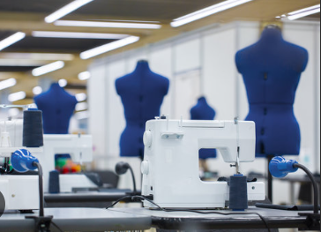
STAKEHOLDERS
End- Users
Fashion enthusiasts, shoppers
Fashion Retailers
Brands listed or partnered on the platform. Increased product visibility, sales
Developers and Designers
Build and maintain the product features
Fashion Influencers
Drive trends and user engagement
10
10

Slide 12




FUTURE POTENTIAL
Supporting Sustainable and Ethical Small Businesses
Connecting consumers with eco-conscious, responsible brands.
Style Advice
• Outfit pairing suggestions via AI
Category Expansion
• Add accessories, footwear, more
• Broaden appeal and engagement
Social Media Integration
• Share finds directly to platforms
• Discover trending styles via tags
11

Slide 13

THANK YOU!
Presented by-
Sowmya Negi - E23CSEU1102
Aarushi Goel - E23CSEU1097
Akshita Parashar - E23CSEU1100

